Slide 1
Case study Repaying The Credit
Learner name : Sakshi Laxman Waghmare
Mentor Name : Shruti Gode

Slide 2
Business Objectives :
Gold Atlantis, a credit-providing firm, observed a rise in the number of defaulters.
Now, the firm is only interested in those customers who have a lower probability of becoming a defaulter.
Is the applicant able to repay the loan ?
Identify those customers who have a lower probability of becoming a defaulter.
Identify the risks to the firm associated with both providing and not providing a loan to the applicant.
1
2
3

Slide 3
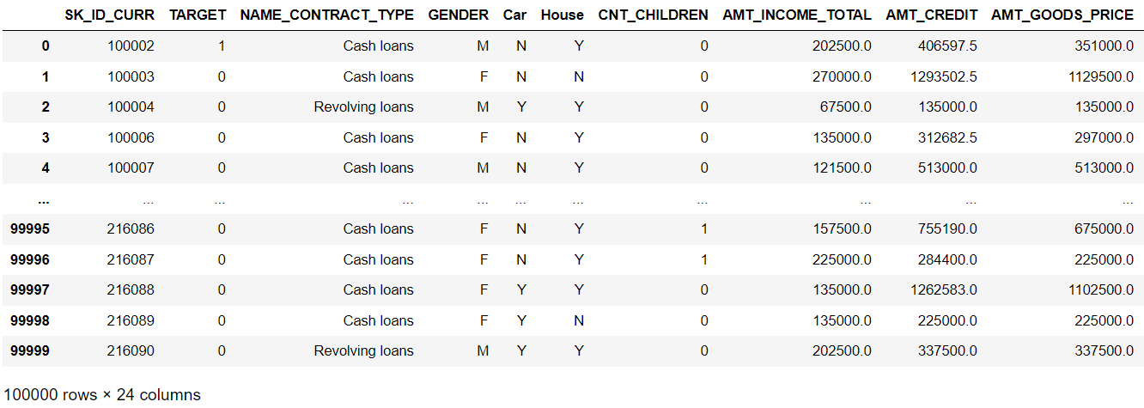
DATASET

Slide 4
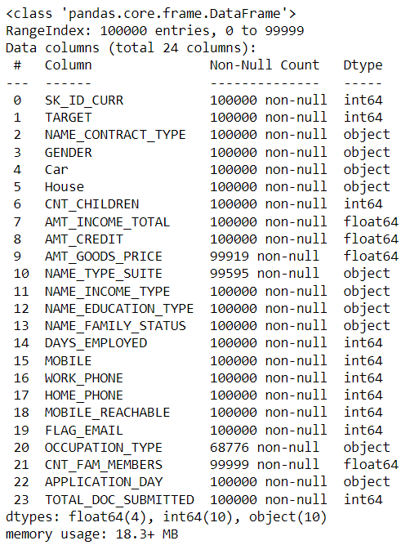

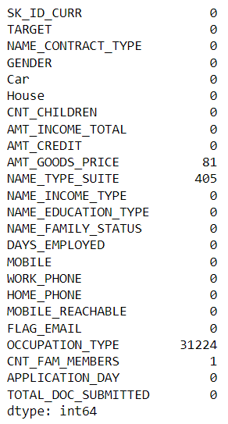
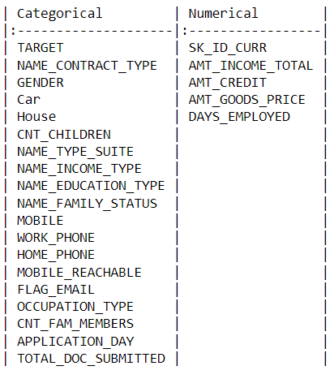
DATA PREPROCESSING
Data Information
Number of Rows & Columns
Count of null Records in data

Slide 5
Univariate analysis :
Categorical data :
8% of clients faced payment difficulties on their installments, while 92% of clients didn't experience any issues with their payments.
Approximately 91% of clients prefer the cash contract type, involving fixed-time installment repayment. and only 8% of clients prefer revolving loans, which offer flexibility in the repayment of installments.
The majority of loan applications come from female clients, constituting 66%, while only 34% of loan applications are from male clients.
Only 34% of clients own their own car; the remaining clients do not have their own car.
The majority of clients, 69%, own their own house, while the remaining clients do not have their own house.
The majority of clients do not have any children.

Slide 6
Categorical data :
More than 50% of clients are working, approximately 20% are commercial associates, 15% are pensioners, and 5% are state servants. The remaining clients fall into categories such as unemployed, students, businessmen, and those on maternity leave.
More than 70% of clients have completed their education up to Secondary/Secondary Special. The remaining clients have backgrounds in higher education, incomplete higher education, lower secondary, and academic degrees.
64% of clients are married, 14% are still single, and the remaining includes those in civil marriages, separated, widowed, and with an unknown marital status.
All clients have provided a mobile phone.
Among all clients, 82% have provided their work phone, while 18% have not.
80% of clients have provided their home phone, while 20% have not.

Slide 7
Categorical data :
Almost all mobile phones are reachable, only a few are not reachable.
94% of clients have not provided an email, while 6% have provided.
The majority of clients are employed as labourers, while others work in roles such as sales staff, accountants, core staff, managers, drivers, and various other fields.
The majority of clients have two family members in their family.
Most clients applied for loans on weekdays, only a few applying on Sundays.
More than 80% of clients submitted only one document during the loan process.

Slide 8
Numerical data :
Column name | Mean | Median | Standard Deviation | Missing values | Skewness
AMT_INCOME_TOTAL | 169426.15 | 144000 | 383506.4 | 0 | 282.94
AMT_CREDIT | 599010.84 | 513315 | 402055.59 | 0 | 1.209
AMT_GOODS_PRICE | 538353.43 | 450000 | 369250.42 | 0 | 1.329
DAYS_EMPLOYED | 63294.26 | -1219.0 | 140841.31 | 0 | 1.676
Note : Missing values filled with the mean.
Income data of clients is skewed, total income of clients is between 50000-350000.
The credit amount data is skewed; most clients have taken credit amounts up to 140000.
The data on prices of goods shows skewness, with prices for goods going up to 1.2 .
Approximately 4000-5000 days before the client started their current employment.

Slide 9
DATA VISUALIZATION

Slide 10
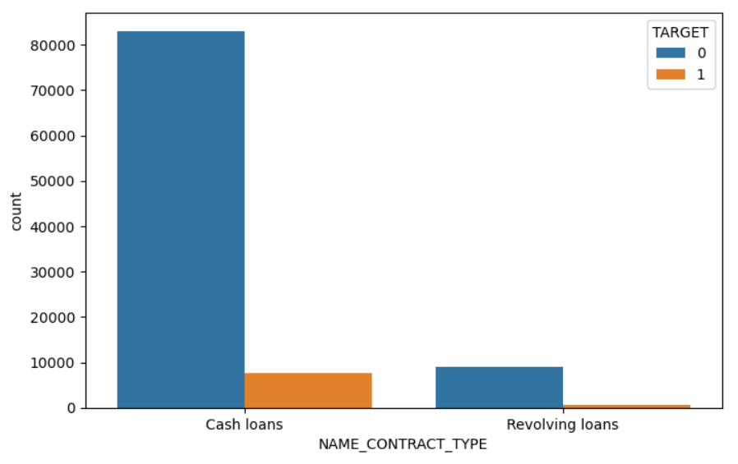
Loan contract type wise Target :
Interpretation :
The ratio of clients who have taken cash loans facing difficulties in repayments is higher, while the majority of clients have applied for cash loans.

Slide 11
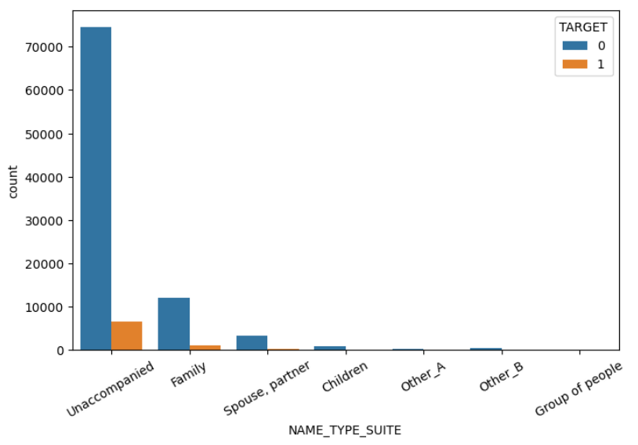
Name Type Suite wise Target :
Interpretation :
The ratio of clients facing difficulties in their repayments is higher when they are unaccompanied, while most of the clients completed their loan process unaccompanied.

Slide 12
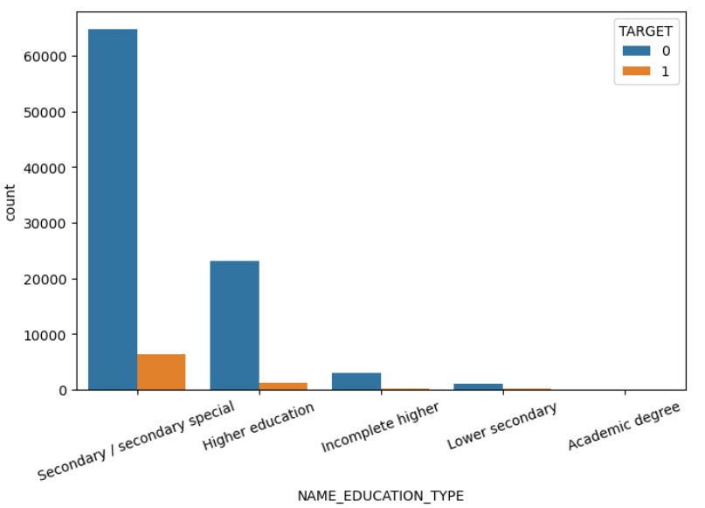
Type of Education wise Target :
Interpretation :
Clients facing difficulties in loan repayments are from a secondary/secondary special educational background, while the majority of clients also have a secondary/secondary special educational background.

Slide 13
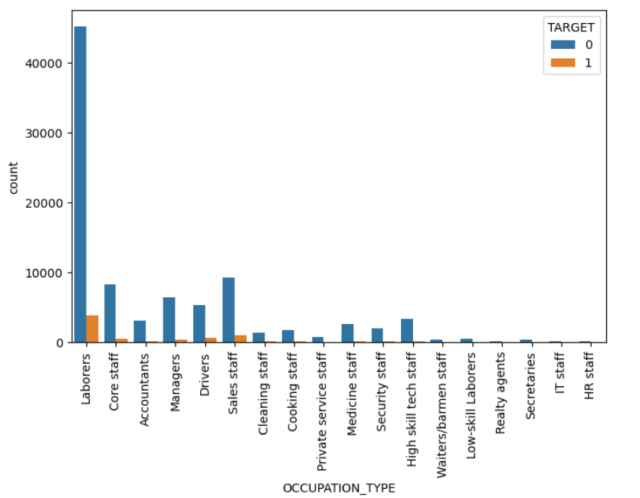
Type of Occupation wise Target :
Interpretation :
Most clients employed in the labourers field are facing difficulties in repaying their loan installments, while the total count of clients employed in the labourers field is also high.

Slide 14
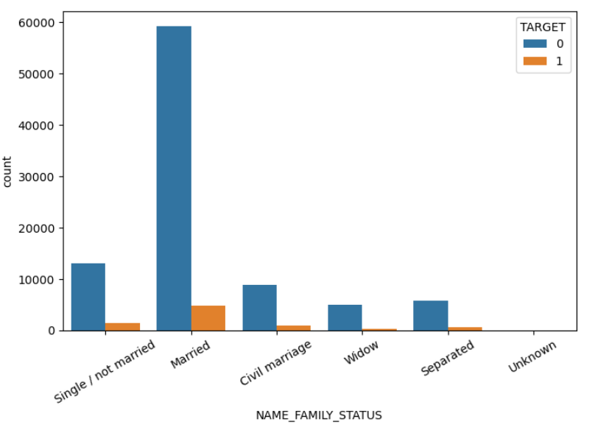
Family Status wise Target :
Interpretation :
The majority of clients are married, and they are facing difficulties in repaying their installments.

Slide 15
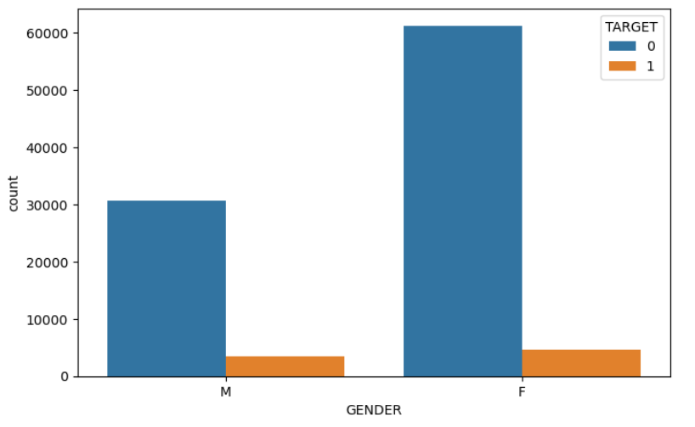
Gender wise Target :
Interpretation :
Female clients are more likely to face difficulties in repaying their installments.

Slide 16
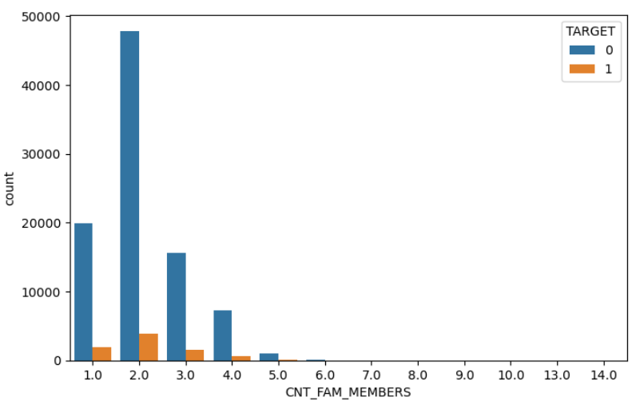
Count of Family Members wise Target :
Interpretation :
Clients with 2 family members are more likely to face difficulties in repaying their loan installments, and clients with 1 and 3 family members are also facing difficulties in their repayments.

Slide 17
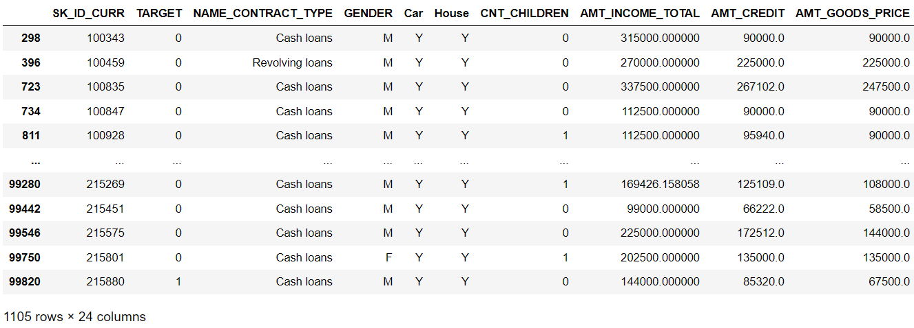
Clients who are able to repay their installments on time and have a lower probability of becoming defaulters.
Considering certain conditions for clients who are able to repay the installments of their loans and have a lower probability of being defaulters.
Clients whose total income is greater than their credit amount are more capable of repaying their installments on time.
Clients who own fixed assets such as a car and a house.
Filtered Data

Slide 18
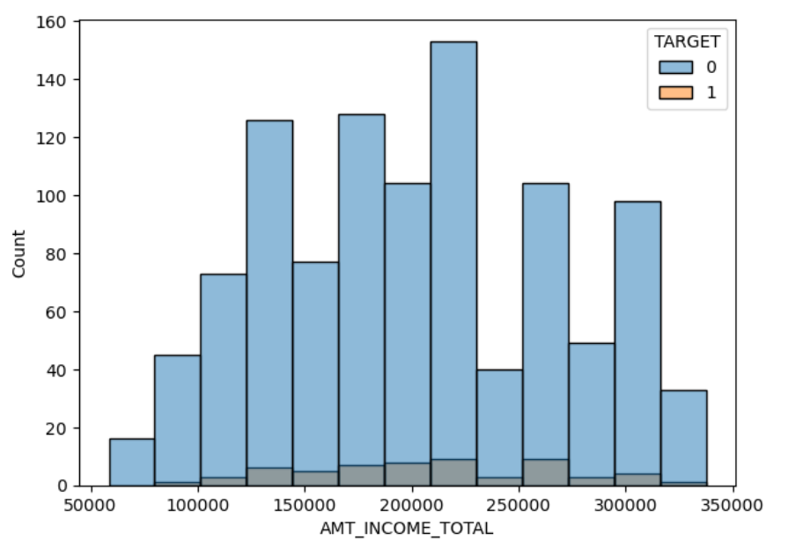
The total income of clients who have a lower probability of becoming defaulters.
Interpretation :
Clients who have a lower probability of becoming defaulters have a total income ranging between 100000 and 350000.

Slide 19
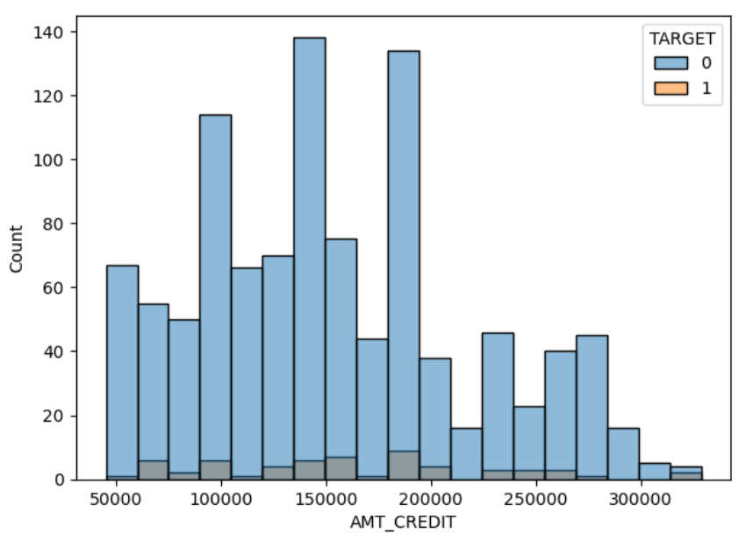
Amount credited by the clients who have a lower probability of becoming defaulters.
Interpretation :
Clients who have a lower probability of becoming defaulters have a credit amount ranging between 50000 and 300000.

Slide 20
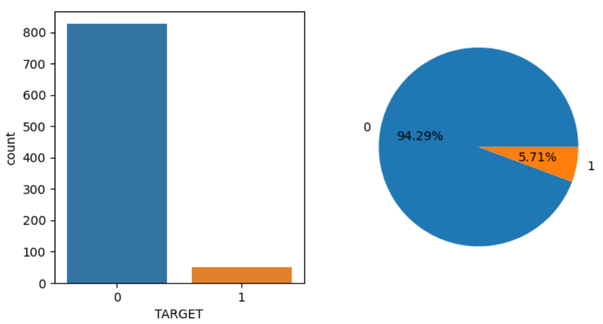
The percentage of clients with a lower probability of becoming a defaulter, categorized by loan contract type.
Cash loans :
Interpretation :
Among clients who have taken cash contract-type loans and are capable of repaying their installments, 6% are facing difficulties in repayment.

Slide 21
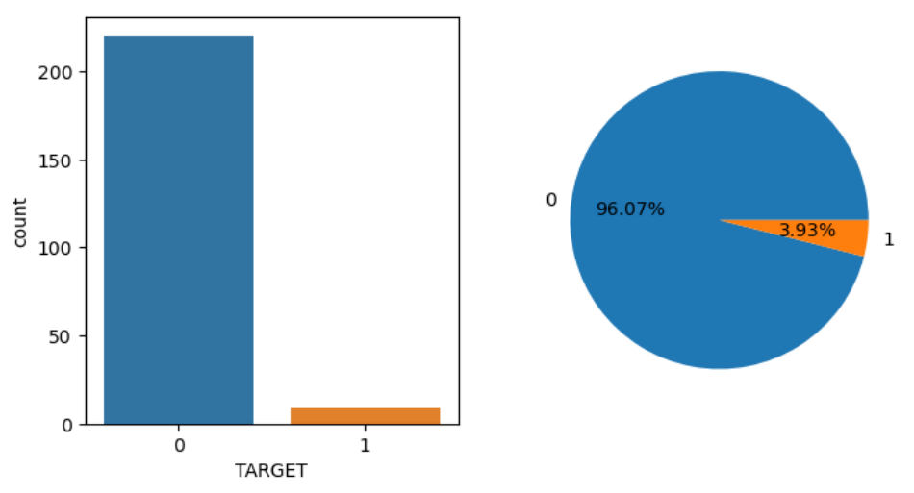
The percentage of clients with a lower probability of becoming a defaulter, categorized by loan contract type.
Revolving loans :
Interpretation :
Among clients who have taken revolving contract-type loans and are capable of repaying their installments, only 4% of them are facing difficulties in repayment.

Slide 22
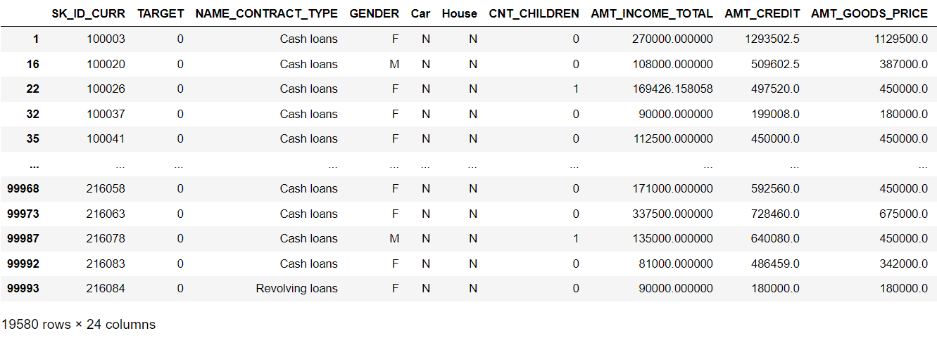
Clients who are likely to become defaulters.
Considering certain conditions for clients who are unable to repay the installments of their loans and are more likely to become defaulters.
Clients with a credit amount higher than their income.
Clients who don't have their own fixed assets.
Filtered Data

Slide 23
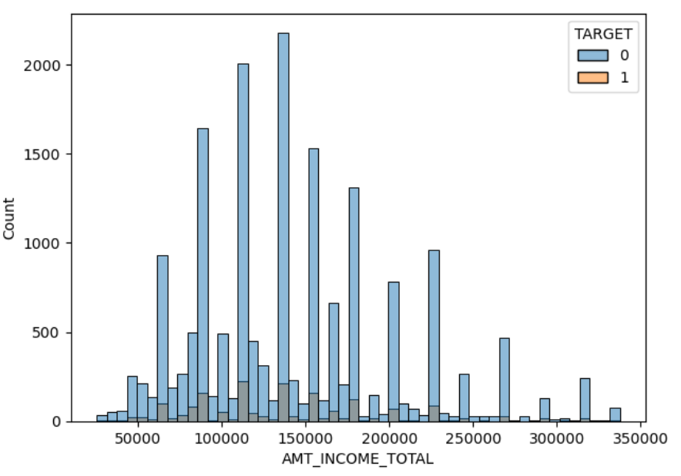
The total income of clients who might become defaulters.
Interpretation :
Clients who are more likely to become defaulters have a total income between 75000 and 230000.

Slide 24
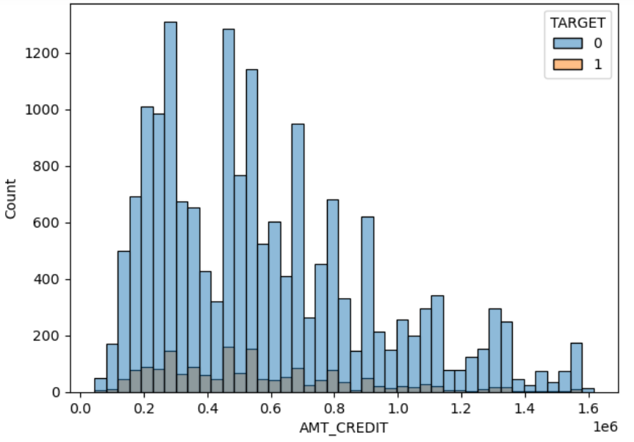
Amount credited by clients who might become defaulters.
Interpretation :
Clients who are more likely to become defaulters have an amount credited between 200000 to 1200000.

Slide 25
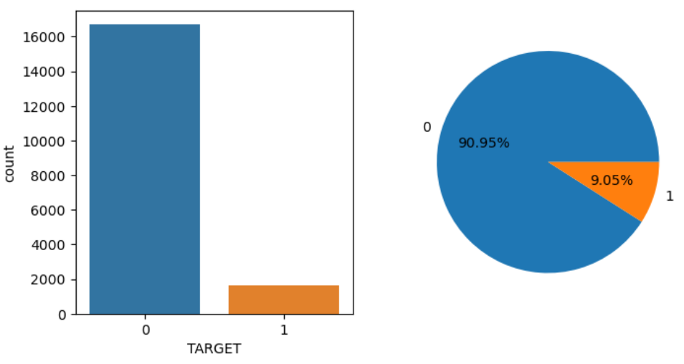
The percentage of clients who might become defaulters, categorized by loan contract type.
Cash loans :
Interpretation :
Among clients who have taken cash contract-type loans and may not be able to repay their installments, 9% are facing difficulties in repayment.

Slide 26
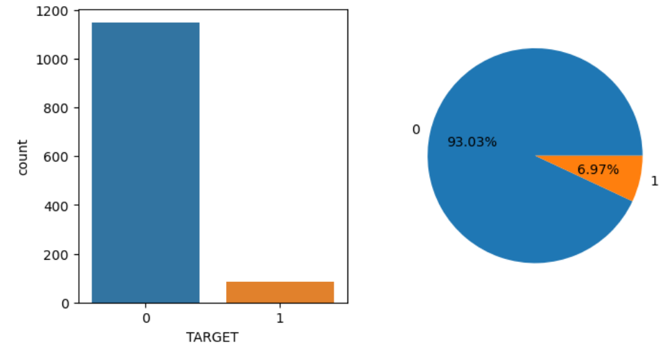
The percentage of clients who might become defaulters, categorized by loan contract type.
Revolving loans :
Interpretation :
Among clients with revolving contract-type loans who may struggle to repay their installments, 7% of them are facing difficulties in repayment.

Slide 27
Interpretation :
Lower probability of becoming defaulters :
Clients who own fixed assets such as a house and a car are more likely to repay their installments on time.
Clients whose total income is greater than the amount they have credited can surely repay their installments on time
Only 6% probability of default is observed in cash contract-type loans, compared to 4% in revolving contract-type loans.
Clients who have sufficient fixed income and own fixed assets such as cars and houses are the ones who are able to repay their installments on time.

Slide 28
Interpretation :
More likely to become defaulters :
Clients who don't own fixed assets such as houses and cars may indicate that their financial condition is not particularly strong.
Clients whose total income is less than the amount credited to them may struggle to repay their installments on time.
Approximately 9% of clients become defaulters in cash contract-type loans, compared to 7% in revolving contract-type loans.
Clients who don't have a fixed income source and don’t have any fixed assets may not be able to repay their installments on time.

Slide 29
Recommendation :
The criteria for clients with a lower probability of becoming defaulters include :
Clients must have their own fixed assets, such as a house, car, etc.
Clients must have a fixed source of income.
If the income is not substantial, clients have less family members in their Families.
If the client's total income is greater than the credited amount, there may be lower chances of them becoming defaulters, and the transaction will be approved.
Clients must be well-educated and employed in a reputable field.
If incoming clients meet these conditions, there may be a lower probability of them becoming defaulters.

Slide 30
THANK YOU…!

